Slide 1

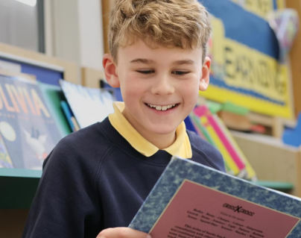
Application Pack
Cover Supervisor
To commence in February 2026

Slide 2
Welcome
Thank you for your interest in our fantastic school.
Children at Northwick experience a truly personal journey where they feel valued and able to flourish, supported by inspiring teachers and an array of superb educational, and co-curricular opportunities. Happy children succeed, and we place the relationships between staff, children and parents at the forefront of all we do.
This is truly a remarkable and welcoming community to be a part of, for both staff and pupils.
Overview
Northwick Manor is a primary school located in Worcester. It has 600 pupils from age [4 – 11 years] and 82 staff numbers. Established over 80 years ago, the school joined The Rivers CofE Academy Trust in 2018.
Ethos
At Northwick we place a high value on the educational experience of all our pupils and achieve this within the atmosphere of a friendly learning community. The school’s principal philosophy is that ‘pupils should be confident, happy, and successful’. Together we aim to be a school of excellence, always encouraging our children to aim high, and providing opportunities for them to develop their talents and potential in a nurturing environment.
Performance
At Northwick, 92% of pupils met the expected standard in their Phonics Screening Test [2025] and 68.5% of pupils met the expected standard in Reading, Writing and Mathematics Combined at Key Stage 2.
Our latest Ofsted judgment: Outstanding
Review score
"We love the school, couldn't be happier
with my child's progress“.
Parent

Slide 3





About Us
The Rivers C of E Academy Trust is a multi-academy school trust, specialists in early years and primary provision, serving over 5250 pupils across three local authorities: Worcestershire, Dudley and Sandwell. ​
Established in 2014, The Rivers C of E Academy Trust now comprises of a respected teaching alliance, sixteen ‘Good’ and ‘Outstanding’ primary, first, and nursery settings and an alternative provision. We are a connected learning community with a shared aim to create ‘an extraordinary education for every pupil’. ​
We are a community of schools with a ‘Christian ethos’, welcoming families from all faiths and no faiths, but together we are guided by our shared mission, vision and values. ​
Our STARS Values
Sharing
Trust
Achievement
Our Mission
Extraordinary Education ​
Extraordinary People ​
Extraordinary Futures
Respect
Our Vision
Through an extraordinary education, we empower pupils to be life-long learners and see their limitless potential. Respectful relationships and an unwavering focus on discovering talents and interests enable pupils to flourish and be extraordinary people. Together, we spark aspiration and drive achievement, so that pupils contribute positively to society and to their extraordinary futures in an ever-changing world.
Safety

Slide 4
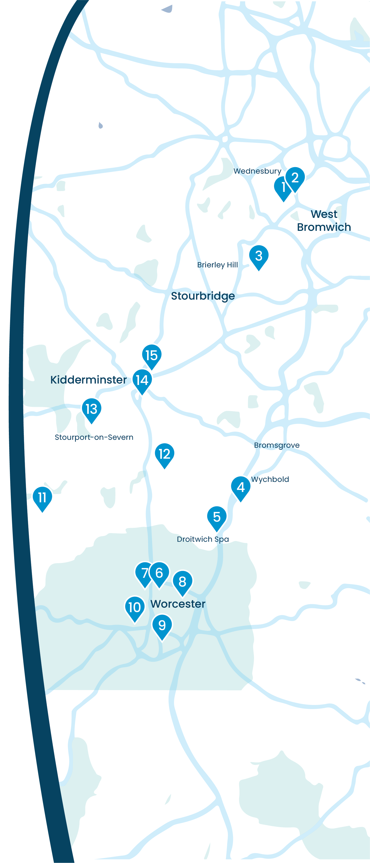















Our Schools
Summerhill Primary Academy Summerhill's Little Treasures
Jubilee Park Academy
Dudley Wood Primary School
Wychbold First and Nursery School
St Peter's Droitwich CofE Academy
North Worcester Primary Academy
Northwick Manor Primary School
Cranham Primary School
Cherry Orchard Primary School
St Clement's CofE Primary School and Pre-School
Great Witley CE Primary School
Cutnall Green CofE Primary School
Burlish Park Primary School
Heronswood Primary School
Unity Academy

Slide 5
Staff Benefits
We believe that collaboration and staff wellbeing are at the heart of our success.
Supported by our trust, we offer a range of benefits to enhance our work environment and support the professional and personal growth of our staff, including work-life balance.
Education Mutual
Staff can access a comprehensive range of healthcare services through Education Mutual, including mental health support, 24/7 GP Healthline, physiotherapy, stress management resources, and occupational health services.
Find out more about Healthcare and Wellbeing Services here: www.educationmutual.co.uk/service/healthcare-and-wellbeing/
Local Government Pension Scheme (LGPS)
The Local Government Pension Scheme (LGPS) is a defined benefit plan, meaning your pension is calculated based on your salary and length of service and adjusted for inflation. This ensures a secure and guaranteed income in retirement, unaffected by investment performance.
Find out more about LGPS here: www.lgpsmember.org/
Other staff benefits include:
Competitive salary
Six INSET days per year
Protected CPL time
Continued professional development pathway for every role
No work communication outside working hours
Excellent holiday entitlement for support staff: Bank holidays plus 25 days paid holiday (pro rata)
5 days extra paid holiday after 5 years’ service (pro rata)
Time for You’ day
Family-friendly policies including flexible working, occupational maternity and paternity pay
Reasonable release time for significant personal events
Length of service awards
Resources for retirement and financial planning
Cycle-to-work scheme
Free tea, coffee and milk

Slide 6
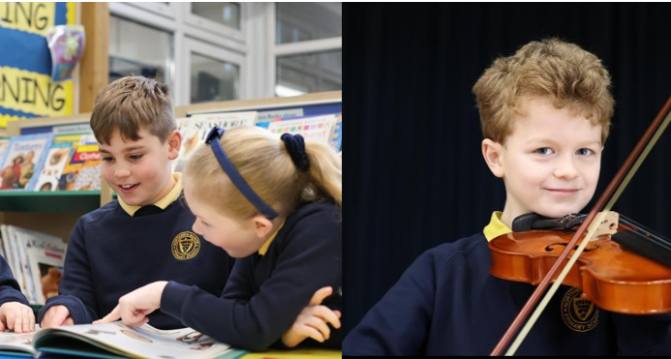
About the Role
Job Title:
Salary:
Contract Type:
Reporting to:
Start Date:
HLTA /Cover Supervisor
TA4 (Scale 18-22) Actual salary £22,330.68 - £24,000.24
Permanent (term time plus TED days), 30 hours per week
Deputy Head / Year Group Lead / Class teachers
ASAP
About
We are looking to appoint a HLTA/ Cover Supervisor to work within the school and welcome applications from candidates with relevant experience. We are looking to appoint a person who will share our vision for high quality education for all our children.
As a HLTA / Cover Supervisor at Northwick, you will play a vital role in ensuring the continuity of learning and maintaining a positive educational environment for our children. You will work across the whole age and ability range, undertaking whole class work, working independently to undertake PPA cover and/or cover appropriately for absent teachers as required.
You will have line management responsibility of a small team and also be required to support in the organisation of the school day, cover timetable and duty rotas.

Slide 7
Job Description
Core Purpose
Organise the whole school daily cover and duty rotas supporting the smooth running of the school.
Assist with all aspects of the school day when classroom cover is not required by liaising with Deputy Head and working with individual pupils / groups as directed.
Supervision of whole classes across the school during the long and short-term absence of the class teacher. This includes delivering pre-planned lessons, managing pupil behaviour, assisting pupils in relevant activities and liaising with class teachers or subject leaders.
To support SLT in the implementation of all aspects of school in order to maintain the aims and ethos of the school and the Trust as a whole.
To demonstrate Trust values and high standards of professional conduct at all times
Key Accountabilities
To provide short-term cover within any age group in response to teacher absence.
To teach whole classes as part of PPA provision according to the PPA timetable.
To ensure that the covering staff are used to their full capacity and that appropriate cover arrangements are made for absent teachers and teaching assistants, including arranging for break, lunch and duties to be covered.
To work collaboratively with the teaching staff to plan delivery of lessons and support for groups of pupils and individuals.
To create and maintain a purposeful and orderly learning environment for pupils. This includes lessons, registration, and other duties where supervision is needed.
To ensure that the work set by the teacher is carried out and that pupils have appropriate equipment and materials to enable them to complete the tasks set and answering pupils’ questions about processes and procedures.
Produce independently of the teacher lesson plans, worksheets, learning objectives, within agreed system of supervision.
Effectively contribute to the selection and preparation of teaching resources/methods that meet the diversity of pupils’ needs and interests to facilitate agreed learning activities.
To support expectations of pupil behaviour in the classroom, securing appropriate standards of discipline and ensuring that the schools Behaviour policy is adhered to.
To devise clearly structured activities that interest and motivate learners and advance their learning
To use your ICT skills to advance learning.

Slide 8
Job Description (cont)
Key Accountabilities
Undertake marking of pupils’ work and accurately record achievement/progress, administer and assess routine tests and assessments.
Assess the needs of pupils and use detailed knowledge and specialist skills to support pupil learning
Provide objective and accurate feedback and reports as required, to the teacher on pupil achievement, progress and other matters, ensuring the availability of appropriate evidence .
Contribute to the creation of specialist resources e.g. visual supports for individuals / groups of pupils, which meet the needs of the pupils.
Assist with the supervision of pupils out of lesson times, including breakfast club, break and lunchtimes and clubs. Take class registers as required.
Provide additional support for individual pupils enabling them to maintain their access to learning which may include personal care, pastoral support, facilitating the use of specialist equipment
Co-ordinate and lead lunchtime/break time supervision of pupils and promote activities and breakout areas.
Be involved in planning, organising and implementing IEPs including attendance at and contribution to reviews.
Run intervention groups and provide support to individual pupils with special needs or those pupils in receipt of targeted pupil premium funded support to address gaps in their learning and support them to make progress.
Promote and support the inclusion of all pupils, including those with specific needs, both in the classroom as part of first-quality teaching and through intervention work.
Be involved in planning, organising and implementing IEPs including attendance at and contribution to reviews.
Accompany teaching staff and students on visits, trips and out of school activities.
To participate in Enrichment and delivery of clubs.
To provide administrative and clerical support to staff and other TAs as required.
Manage a team of teaching assistants as directed by SLT.
Support with the invigilation of tests and assessments as and when requested to do so.

Slide 9
Job Description (cont)
Other
To have professional regard for the ethos, policies and practices of the school in which you teach, and maintain high standards in your own attendance and punctuality
Be aware of, and comply with, policies and procedures relating to child protection, health and safety, security, confidentiality and data protection, reporting all concerns to an appropriate person.
Perform any reasonable duties as requested by the Headteacher.
Continuing Professional Development
Participate in training and other learning activities to develop the competencies to effectively support children and to ensure knowledge and skills are kept up to date.
Attend team and staff meetings.
Conditions of Employment
The School reserves the right to alter the content of this Job Description, after consultation, to reflect changes to the job or services provided, without altering the general character or level of responsibility.
The duties described in this Job Description must be carried out in a manner which promotes equality of opportunity, dignity and due respect for all employees and service users and is consistent with the School’s Equal Opportunities Policy and Code of Conduct.

Slide 10
Person Specification
Criteria | Essential | Desirable
Education / Qualifications | Qualified HLTA Good numeracy/literacy skills. 5 GCSE’s with a minimum of Grade C or above in Maths and English (or equivalent qualifications) | Evidence of further CPD Current First Aid/Paediatric First Aid certificate Qualifications/training in social/emotional programmes, e.g. Elsa or Thrive / trauma informed practice Team Teach trained Training in the relevant learning strategies to support children with a range of needs
Experience | Experience of assisting pupils in their learning from across the Primary Age Range Minimum 2 years experience of working with children as a Teaching Assistant in an educational setting Experience of teaching whole classes as a HLTA or in a similar role Experience of working with pupils with a range of additional educational needs, more able and special educational needs Experience in planning and delivering challenging engaging and enjoyable learning activities Experience of leading learning in large groups or class sessions in teacher absence Good understanding of behaviour management and ability to apply a range of behaviour strategies which contribute to a purposeful learning environment Good understanding of how children learn | Responsibility of attainment and progress for individuals or groups of pupils Delivering synthetic phonics
Skills and knowledge | Demonstrate knowledge and understanding of the HLTA standards Understand the key factors that affect children's learning and progress Know how to contribute to effective personalised provision Have an understanding of what constitutes high quality educational provision and the characteristics of effective learning Be competent in the use of IT to support learning Know how statutory and non‐statutory frameworks for the school curriculum relate to the age and ability ranges of the learners you support Understand the objectives, content and intended outcomes for the learning activities in which you are involved Know how to support learners in accessing the curriculum in accordance with the special educational needs (SEND) code of practice and equalities legislation | Ability to deliver targeted support programmes
Personal qualities | Ability to establish positive relationships with staff , pupils and parents Flexible and keen to adapt to the needs of the school. Be encouraging and supportive. High standards and expectations of pupils and yourself A positive outlook towards teaching and aiding children's development. Ability to work autonomously with minimum supervision, or as part of a team as necessary Being solution focussed Commitment to a collaborative approach to professional development Commitment to safeguarding and equality Self-motivated and well organised Commitment to maintaining confidentiality at all times. compassionate and patient approach Emotional resilience in working with challenging behaviours.

Slide 11
How to Apply
Application forms are available to download here:
Please email completed application forms to Miranda Giddings, nwoffice@riverscofe.co.uk by Tuesday 10th February 2026.
Interviews will take place on Wednesday 25th February 2026.
We do not accept CVs.
We are committed to safeguarding and promoting the well-being of children and expect everyone to share this commitment. The successful applicant will undergo a full enhanced DBS check.

Slide 12
Get in Touch
Northwick Manor Primary School
Northwick Road, Worcester WR3 7EA
T: 01905 454430
E: nwoffice@riverscofe.co.uk
Northwick Manor Primary School – Home
The Rivers C of E Academy Trust
School Lane, Cutnall Green, Droitwich, WR9 0PH
T: 01299 851178
E: info@riverscofe.co.uk
W: www.riverscofe.co.uk/

