Slide 1

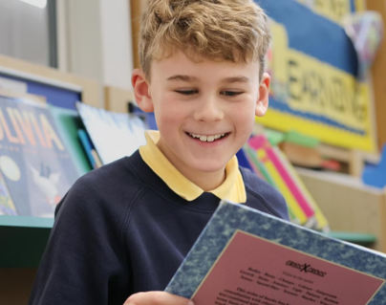
Application Pack
Kitchen Assistant x 2

Slide 2
Welcome
Thanks for your interest in our fantastic school.
Children at Northwick experience a truly personal journey where they feel valued and able to flourish, supported by inspiring teachers and an array of superb educational, and co-curricular opportunities. Happy children succeed, and we place the relationships between staff, children and parents at the forefront of all we do.
This is truly a remarkable and welcoming community to be a part of, for both staff and pupils.
Overview
School overview template
Northwick Manor is a primary school located in Worcester.
It has 600 pupils from age [4 – 11 years] and 82 staff numbers.
Established over 80 years ago, the school joined The Rivers CofE Academy Trust in 2018.
Ethos
At Northwick we place a high value on the educational experience of all our pupils and achieve this within the atmosphere of a friendly learning community. The school’s principal philosophy is that ‘pupils should be confident, happy, and successful’. Together we aim to be a school of excellence, always encouraging our children to aim high, and providing opportunities for them to develop their talents and potential in a nurturing environment.
Performance
At this school 92% of pupils met the expected standard in their Phonics Screening Test [2024] and 68.5% of pupils met the expected standard in Reading, Writing and Mathematics Combined at Key Stage 2.
Our latest Ofsted judgment: Outstanding
Review score
"We love the school, couldn't be happier
with my child's progress“.
Parent

Slide 3





About Us
The Rivers C of E Academy Trust is a multi-academy school trust, specialists in early years and primary provision, serving over 5250 pupils across three local authorities: Worcestershire, Dudley and Sandwell. ​
Established in 2014, The Rivers C of E Academy Trust now comprises of a respected teaching alliance, sixteen
‘Good’ and ‘Outstanding’ primary, first,
and nursery settings and an alternative provision. We are a connected learning community with a shared aim to create
‘an extraordinary education for every pupil’. ​
We are a community of schools with a ‘Christian ethos’, welcoming families from all faiths and no faiths, but together we are guided by our shared mission, vision and values. ​
Our STARS Values
Sharing
Trust
Achievement
Our Mission
Extraordinary Education ​
Extraordinary People ​
Extraordinary Futures
Respect
Our Vision
Through an extraordinary education,
we empower pupils to be life-long learners and see their limitless potential. Respectful relationships and an unwavering focus on discovering talents and interests enable pupils to flourish and be extraordinary people. Together, we spark aspiration and drive achievement, so that pupils
contribute positively to society and to
their extraordinary futures in an
ever-changing world.
Safety

Slide 4
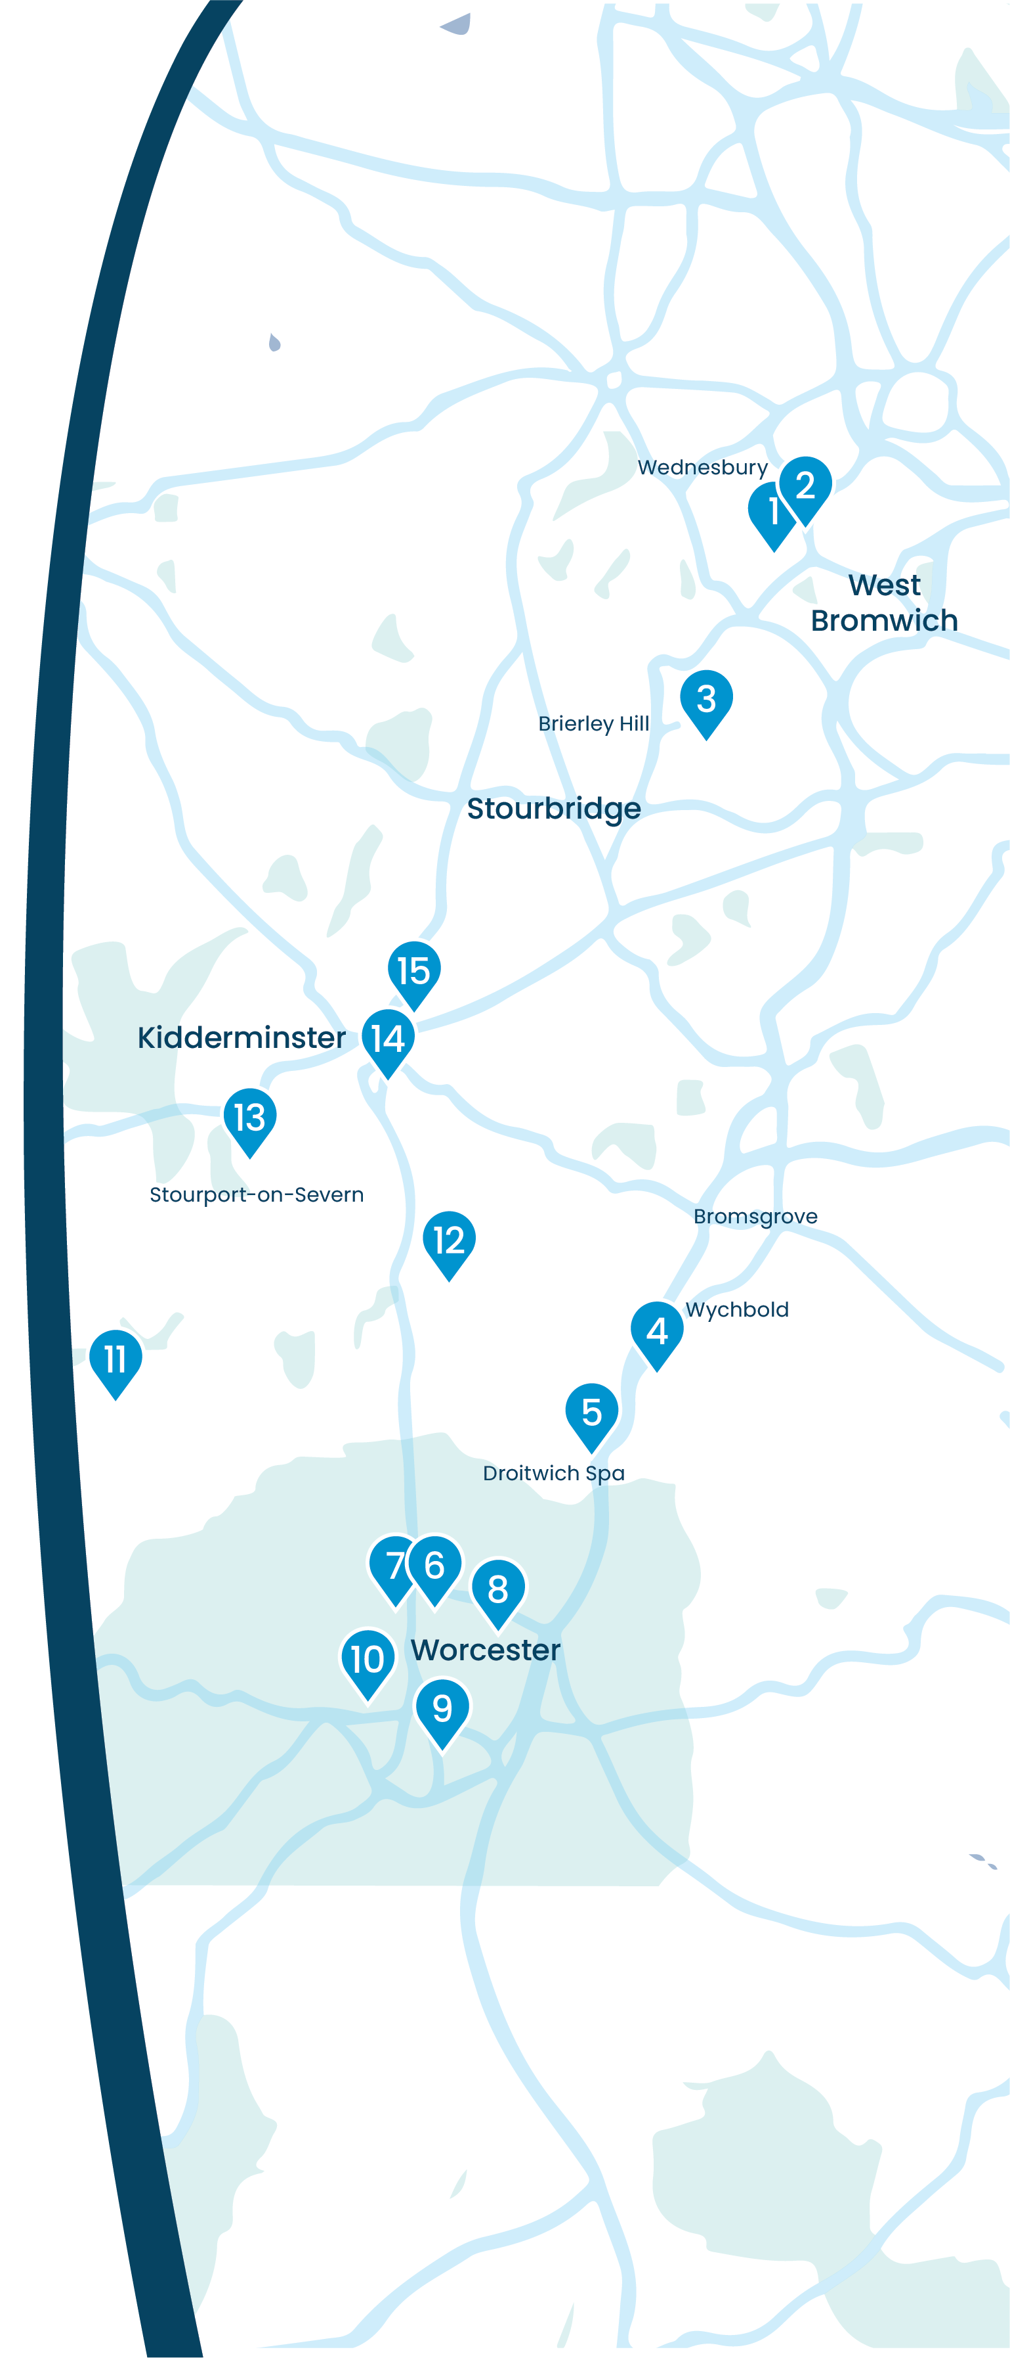















Our
Schools
Summerhill Primary Academy Summerhill's Little Treasures
Jubilee Park Academy
Dudley Wood Primary School
Wychbold First and Nursery School
St Peter's Droitwich CofE Academy
North Worcester Primary Academy
Northwick Manor Primary School
Cranham Primary School
Cherry Orchard Primary School
St Clement's CofE Primary School and Pre-School
Great Witley CE Primary School
Cutnall Green CofE Primary School
Burlish Park Primary School
Heronswood Primary School
Unity Academy

Slide 5
Staff Benefits
We believe that collaboration and staff wellbeing are at the heart of our success.
Supported by our trust, we offer a range of benefits to enhance our work environment and support the professional and personal growth of our staff, including work-life balance.
Education Mutual
Staff can access a comprehensive range of healthcare services through Education Mutual, including mental health support, 24/7 GP Healthline, physiotherapy, stress management resources, and occupational health services.
Find out more about Healthcare and Wellbeing Services here: www.educationmutual.co.uk/service/healthcare-and-wellbeing/
Local Government Pension Scheme (LGPS)
The Local Government Pension Scheme (LGPS) is a defined benefit plan, meaning your pension is calculated based on your salary and length of service and adjusted for inflation. This ensures a secure and guaranteed income in retirement, unaffected by investment performance.
Find out more about LGPS here: www.lgpsmember.org/
Other staff benefits include:
Competitive salary
Six INSET days per year
Protected CPL time
Continued professional development pathway for every role
No work communication outside working hours
Excellent holiday entitlement for support staff: Bank holidays plus 25 days paid holiday (pro rata)
5 days extra paid holiday after 5 years’ service (pro rata)
Time for You’ day
Family-friendly policies including flexible working, occupational maternity and paternity pay
Reasonable release time for significant personal events
Length of service awards
Resources for retirement and financial planning
Cycle-to-work scheme
Free tea, coffee and milk

Slide 6

About the Role
Job Title:
Kitchen Assistant x 2
Salary:
£14,169.84 – 25 hours vacancy
£5,667.96 – 10 hours vacancy
Contract Type:
Permanent
Reporting To:
Catering Manager
Location:
Northwick Manor Primary School
About:
Vacancy 1
9.00am – 2.00pm, Monday to Friday, Term Time only plus TED days 25 hours per week
Vacancy 2
12.00pm – 2.00pm, Monday to Friday, Term Time only plus TED days, 10 hours per week

Slide 7
Job Description
Main Duties and Responsibilities:
Undertaking basic food preparation.
Serving hot lunches to pupils and staff.
Ensuring the food safety of pupils with special diets.
Maintaining a clean and organised kitchen environment, to include
  washing dishes
  sanitising surfaces
  disposing of waste appropriately.
Completing a cleaning rota.
Packing and delivering food to export sites when required.
Maintaining a high standard of Food Hygiene and Health and Safety, to ensure safe practices are followed.
Attending any training as required.
Carrying out any other duties within the grade as and when required.

Slide 8
Person Specifications
Criteria | Essential | Desirable
Qualifications and experience | Experience in working in a busy kitchen | Food Hygiene certificate
Skills and knowledge | Ability to work under tight deadlines. Ability to use own initiative. | Good understanding of food hygiene practices. Awareness of allergens.
Other |  | Own transport

Slide 9
How to Apply
Application forms are available to download here: Current Vacancies | The Rivers CofE Multi Academy Trust
Please email completed application form to Jacqui Tombs, School Business Manager nwoffice@riverscofe.co.uk by 1st September 2025.
Please note that if you have not been contacted by 2nd September then you have not been successfully shortlisted on this occasion.
Interviews will be held on Friday 5th September 2025.
There is no need to submit a curriculum vitae.
We are committed to safeguarding and promoting the well-being of children and expect everyone to share this commitment. The successful applicant will undergo a full enhanced DBS check.

Slide 10
Get in Touch
Northwick Manor Primary School
Northwick Road, Worcester WR3 7EA
T: 01905 454430
E: nwoffice@riverscofe.co.uk
Northwick Manor Primary School – Home
The Rivers C of E Academy Trust
School Lane, Cutnall Green, Droitwich, WR9 0PH
T: 01299 851178
E: info@riverscofe.co.uk
W: www.riverscofe.co.uk/

