Slide 1


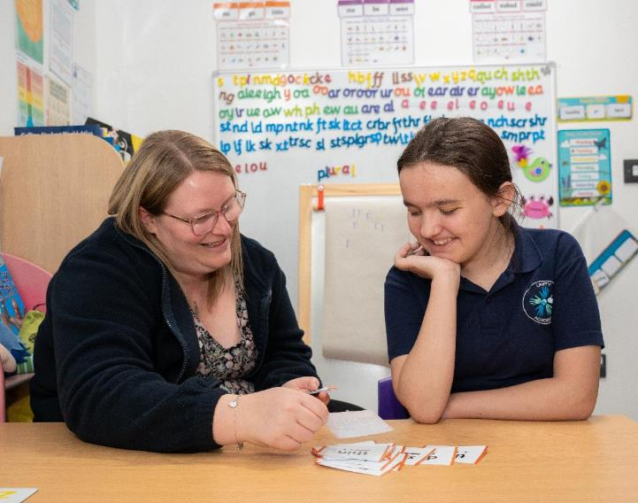
Application Pack
Teaching Assistant level 3 plus SEN Allowance – 30 hours per week TTO plus 5 TED days

Slide 2
Welcome
Welcome from the Headteacher
Thank you for your interest in joining Unity Academy, Kidderminster. We are a vibrant and inclusive school committed to nurturing the potential of every child and fostering a culture of excellence, respect, and ambition.
At Unity Academy, our staff are at the heart of everything we do. We believe in creating a supportive and collaborative working environment where every team member feels valued and empowered to grow professionally. Whether you're early in your career or bring a wealth of experience, we welcome your passion, creativity, and commitment to making a real difference in the lives of our pupils.
Warm regards, Gemma Willetts Headteacher, Unity Academy
Overview
Unity Academy
Unity Academy is a primary alternative provision located in Kidderminster.
It has 40 pupils from age 5 – 11 years and 26 staff members.
Established in 2023 the school is part of The Rivers CofE Academy Trust.
Ethos
At Unity Academy, Kidderminster, our ethos is shaped by the STARS values of The Rivers CofE Academy Trust: Sharing, Trust, Achievement, Respect and Safety. These guiding principles underpin every aspect of school life and help us to cultivate a nurturing and high-achieving environment where every pupil can flourish.
We are committed to providing an education that develops the whole child—academically, socially, morally, and spiritually. Through high-quality teaching, a broad and balanced curriculum, and strong pastoral care, we aim to inspire a lifelong love of learning and a strong sense of personal responsibility.
By living out our STARS values, we create a culture of kindness, excellence, and aspiration. Pupils are encouraged to serve others, show gratitude, strive for their best, and treat everyone with dignity. This ethos empowers our children to grow into thoughtful, resilient individuals who are well prepared for the challenges and opportunities ahead.

Slide 3





About Us
The Rivers C of E Academy Trust is a multi-academy school trust, specialists in early years and primary provision, serving over 5250 pupils across three local authorities: Worcestershire, Dudley and Sandwell. ​
Established in 2014, The Rivers C of E Academy Trust now comprises of a respected teaching alliance, sixteen ‘Good’ and ‘Outstanding’ primary, first, and nursery settings and an alternative provision. We are a connected learning community with a shared aim to create ‘an extraordinary education for every pupil’. ​
We are a community of schools with a ‘Christian ethos’, welcoming families from all faiths and no faiths, but together we are guided by our shared mission, vision and values. ​
Our STARS Values
Sharing
Trust
Achievement
Our Mission
Extraordinary Education ​
Extraordinary People ​
Extraordinary Futures
Respect
Our Vision
Through an extraordinary education, we empower pupils to be life-long learners and see their limitless potential. Respectful relationships and an unwavering focus on discovering talents and interests enable pupils to flourish and be extraordinary people. Together, we spark aspiration and drive achievement, so that pupils contribute positively to society and to their extraordinary futures in an ever-changing world.
Safety

Slide 4
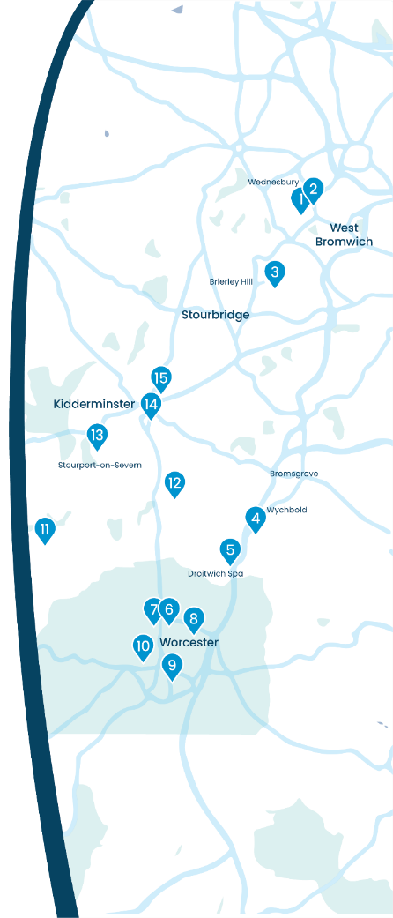















Our Schools
Summerhill Primary Academy Summerhill's Little Treasures
Jubilee Park Academy
Dudley Wood Primary School
Wychbold First and Nursery School
St Peter's Droitwich CofE Academy
North Worcester Primary Academy
Northwick Manor Primary School
Cranham Primary School
Cherry Orchard Primary School
St Clement's CofE Primary School and Pre-School
Great Witley CE Primary School
Cutnall Green CofE Primary School
Burlish Park Primary School
Heronswood Primary School
Unity Academy

Slide 5
Staff Benefits
We believe that collaboration and staff wellbeing are at the heart of our success.
Supported by our trust, we offer a range of benefits to enhance our work environment and support the professional and personal growth of our staff, including work-life balance.
Education Mutual
Staff can access a comprehensive range of healthcare services through Education Mutual, including mental health support, 24/7 GP Healthline, physiotherapy, stress management resources, and occupational health services.
Find out more about Healthcare and Wellbeing Services here: www.educationmutual.co.uk/service/healthcare-and-wellbeing/
Local Government Pension Scheme (LGPS)
The Local Government Pension Scheme (LGPS) is a defined benefit plan, meaning your pension is calculated based on your salary and length of service and adjusted for inflation. This ensures a secure and guaranteed income in retirement, unaffected by investment performance.
Find out more about LGPS here: www.lgpsmember.org/
Other staff benefits include:
Competitive salary
Six INSET days per year
Protected CPL time
Continued professional development pathway for every role
No work communication outside working hours
Excellent holiday entitlement for support staff: Bank holidays plus 25 days paid holiday (pro rata)
5 days extra paid holiday after 5 years’ service (pro rata)
Time for You’ day
Family-friendly policies including flexible working, occupational maternity and paternity pay
Reasonable release time for significant personal events
Length of service awards
Resources for retirement and financial planning
Cycle-to-work scheme
Free tea, coffee and milk

Slide 6
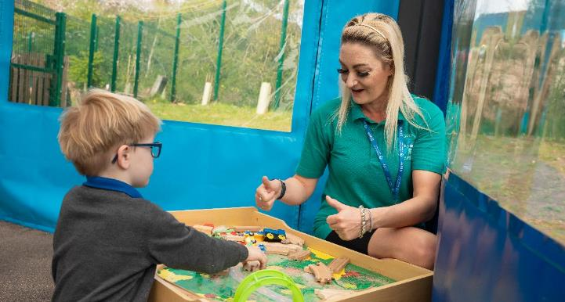
About the Role
Job Title:
Teaching Assistant – TA3
Salary:
TA3 – actual salary £18,761.10 - £21,895.06 plus SEN allowance £1,247.88
Contract Type:
Permanent
Reporting To:
Headteacher
Location:
Unity Academy
About:
Unity Academy has an exciting opportunity for an enthusiastic and talented individual to take the position of Teaching Assistant. Contracted hours will be 30 hours per week, Term-time only plus 5 TED days. This post is being advertised as a permanent position.
The Rivers Academy Trust are keen to support applicants that offer a skill set and are happy to support this through relevant training. The purpose of this post is to support pupils and staff to ensure that all pupils reach their full potential. Working alongside a class teacher in our 2-year-old alternative provision primary academy in Kidderminster, the successful candidate will ideally have experience with working with children with SEMH needs.

Slide 7
Job Description
Key Purpose:
The purpose of this post is to support pupils and staff to ensure that all pupils reach their full potential.
Main Activities:
Supporting the pupil
Assisting pupils in the acquisition of basic literacy and numeracy skills.
To assist pupils in making progress across all subject areas.
Working with pupils on an individual or group basis as required by the class teacher.
Assist in offsite visits
Aid pupils with special needs to access all subjects of the national curriculum and encourage their independence as learners.
Ensure pupils understand instructions.
Motivate and encourage pupils to behave well in and around school.
Acquaint themselves with the support materials in and around the school for individual pupil or group use.
Assist the teacher in developing a supportive and trusting relationship with other adults and children.
Promote and reinforce pupil self-esteem through praise and encouragement.
Be sensitive to the general welfare and care of all pupils within the school, drawing areas of concern to the attention of the class teacher.
Meet the physical and/or hygiene needs of pupils as required.
Act as support worker for children with Emotional and Behavioural Difficulties.
Support children at lunchtime.
Supporting the teacher
Have access to the planned teaching and learning activities for the class.
Record pupil progress to inform future planning for coverage of the national curriculum.
Assist the teacher in evaluation of work undertaken and help plan future progress for identified pupils.
Help with reasonable requests for preparation of materials to support teaching and learning.
Assist with reasonable requests for minor administrative
tasks e.g. photocopying and laminating.
Under the direction of the class teacher, ensure
a safe environment is maintained within
the classroom/ school for all pupils.

Slide 8
Job Description cont’d
Supporting the school
Attend training when appropriate and after consultation with your Line Manager.
Be aware of and support all the schools policies.
Be aware of the school safety procedures e.g. fire drill/ health and safety policy.
Treat as confidential all information on individual pupils and refer parents to the class teacher should any questions about individuals asked.
Foster positive links between home and school.
After negotiation with the line manager, carry out the administration of elementary first aid at break times to pupils throughout the school (qualified staff only).
Perform any reasonable duties as requested by the senior leadership team.
The School reserves the right to alter the content of this Job Description, after consultation, to reflect changes to the job or services provided, without altering the general character or level of responsibility.
The duties described in this Job Description must be carried out in a manner which promotes equality of opportunity, dignity and due respect for all employees and service users and is consistent with the School’s Equal Opportunities Policy and Code of Conduct.

Slide 9
Person Specifications
Qualifications and Experience:
Essential: Experience working within a school setting
Desirable: Evidence of further CPD, Experience of working with children with SEMH needs, First Aid trained, Positive Handling trained.
Skills and Knowledge:
Essential: Ability to work independently, Ability to use own initiative, Excellent understanding of safeguarding issues, Excellent practitioner
Desirable: Good understanding of the National Curriculum, safeguarding training undertaken, Offsite visit trained.
Personal Qualities:
Essential: Enthusiasm and a positive outlook, Excellent attendance and punctuality, Responsible, honest and reliable, Good personal organization, Calm under pressure, A willingness to work alongside young children with challenging behaviour.

Slide 10
How to Apply
Application forms are available to download here: Unity Academy - Vacancies
Please email completed application forms to office-uny@riverscofe.co.uk
Please contact the school office on 01562 215194 if you would like to come and have a look around the school prior to applying.
We are committed to safeguarding and promoting the well-being of children and expect everyone to share this commitment. The successful applicant will undergo a full.
The River C. of E. Academy Trust reserves the right to withdraw the vacancy should a suitable candidate be found at any time during the recruitment process.

Slide 11
Get in Touch
Unity Academy
Hurcott Road, Kidderminster, Worcestershire, DY10 2QJ
T: 01562 215194
E: office-uny@riverscofe.co.uk
W: www.unityacademyap.co.uk
The Rivers C of E Academy Trust
School Lane, Cutnall Green, Droitwich, WR9 0PH
T: 01299 851178
E: info@riverscofe.co.uk
W: www.riverscofe.co.uk/

