Slide 1

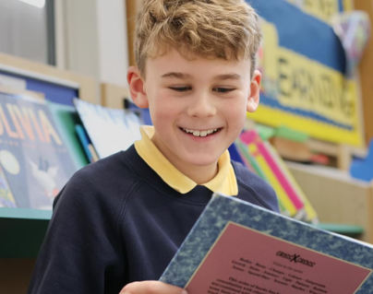
Application Pack
Inclusion Teaching Assistant
To commence in February 2026

Slide 2
Welcome
Thank you for your interest in our fantastic school.
Children at Northwick experience a truly personal journey where they feel valued and able to flourish, supported by inspiring teachers and an array of superb educational, and co-curricular opportunities. Happy children succeed, and we place the relationships between staff, children and parents at the forefront of all we do.
This is truly a remarkable and welcoming community to be a part of, for both staff and pupils.
Overview
Northwick Manor is a primary school located in Worcester. It has 600 pupils from age [4 – 11 years] and 82 staff numbers. Established over 80 years ago, the school joined The Rivers CofE Academy Trust in 2018.
Ethos
At Northwick we place a high value on the educational experience of all our pupils and achieve this within the atmosphere of a friendly learning community. The school’s principal philosophy is that ‘pupils should be confident, happy, and successful’. Together we aim to be a school of excellence, always encouraging our children to aim high, and providing opportunities for them to develop their talents and potential in a nurturing environment.
Performance
At Northwick, 92% of pupils met the expected standard in their Phonics Screening Test [2025] and 68.5% of pupils met the expected standard in Reading, Writing and Mathematics Combined at Key Stage 2.
Our latest Ofsted judgment: Outstanding
Review score
"We love the school, couldn't be happier
with my child's progress“.
Parent

Slide 3





About Us
The Rivers C of E Academy Trust is a multi-academy school trust, specialists in early years and primary provision, serving over 5250 pupils across three local authorities: Worcestershire, Dudley and Sandwell. ​
Established in 2014, The Rivers C of E Academy Trust now comprises of a respected teaching alliance, sixteen ‘Good’ and ‘Outstanding’ primary, first, and nursery settings and an alternative provision. We are a connected learning community with a shared aim to create ‘an extraordinary education for every pupil’. ​
We are a community of schools with a ‘Christian ethos’, welcoming families from all faiths and no faiths, but together we are guided by our shared mission, vision and values. ​
Our STARS Values
Sharing
Trust
Achievement
Our Mission
Extraordinary Education ​
Extraordinary People ​
Extraordinary Futures
Respect
Our Vision
Through an extraordinary education, we empower pupils to be life-long learners and see their limitless potential. Respectful relationships and an unwavering focus on discovering talents and interests enable pupils to flourish and be extraordinary people. Together, we spark aspiration and drive achievement, so that pupils contribute positively to society and to their extraordinary futures in an ever-changing world.
Safety

Slide 4
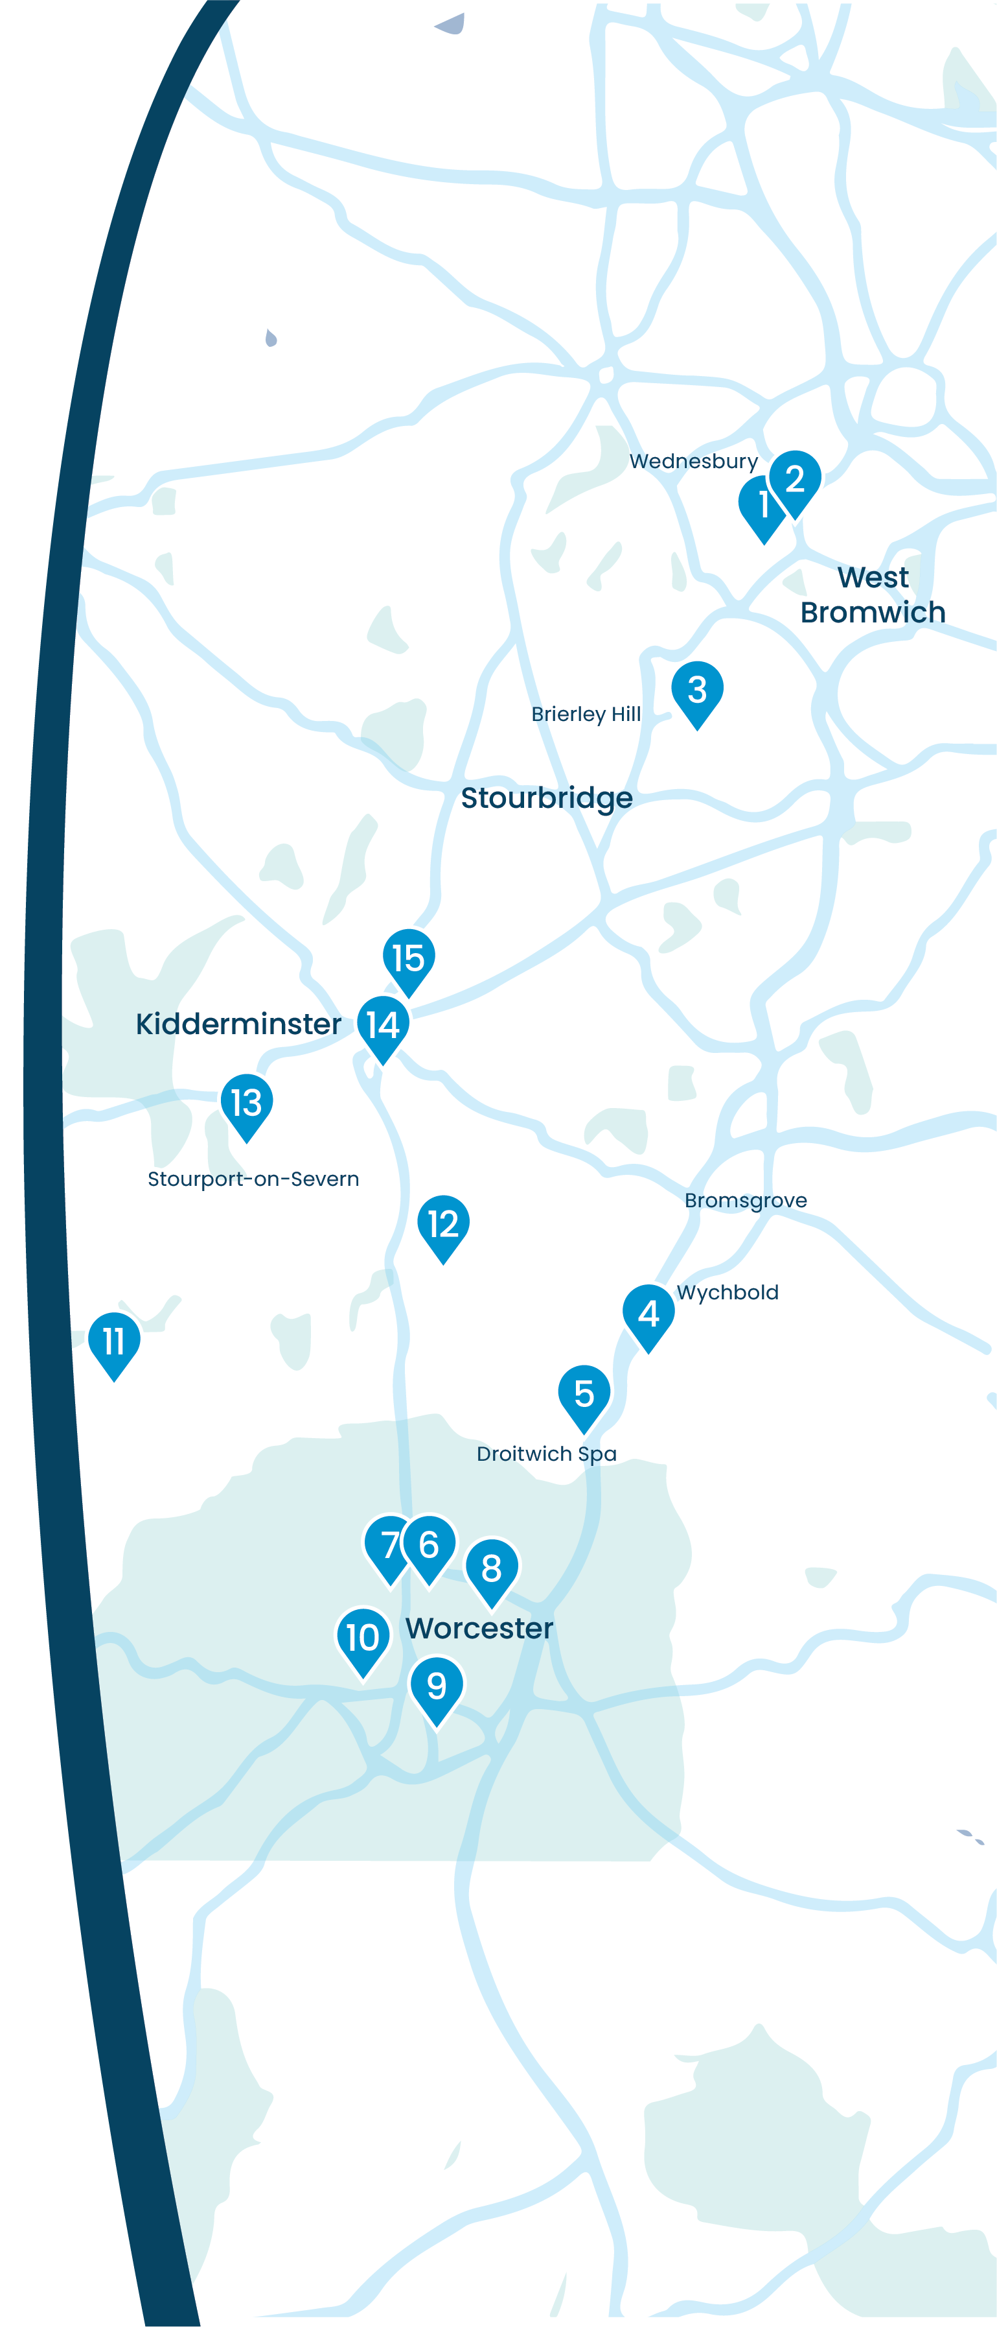















Our Schools
Summerhill Primary Academy Summerhill's Little Treasures
Jubilee Park Academy
Dudley Wood Primary School
Wychbold First and Nursery School
St Peter's Droitwich CofE Academy
North Worcester Primary Academy
Northwick Manor Primary School
Cranham Primary School
Cherry Orchard Primary School
St Clement's CofE Primary School and Pre-School
Great Witley CE Primary School
Cutnall Green CofE Primary School
Burlish Park Primary School
Heronswood Primary School
Unity Academy

Slide 5
Staff Benefits
We believe that collaboration and staff wellbeing are at the heart of our success.
Supported by our trust, we offer a range of benefits to enhance our work environment and support the professional and personal growth of our staff, including work-life balance.
Education Mutual
Staff can access a comprehensive range of healthcare services through Education Mutual, including mental health support, 24/7 GP Healthline, physiotherapy, stress management resources, and occupational health services.
Find out more about Healthcare and Wellbeing Services here: www.educationmutual.co.uk/service/healthcare-and-wellbeing/
Local Government Pension Scheme (LGPS)
The Local Government Pension Scheme (LGPS) is a defined benefit plan, meaning your pension is calculated based on your salary and length of service and adjusted for inflation. This ensures a secure and guaranteed income in retirement, unaffected by investment performance.
Find out more about LGPS here: www.lgpsmember.org/
Other staff benefits include:
Competitive salary
Six INSET days per year
Protected CPL time
Continued professional development pathway for every role
No work communication outside working hours
Excellent holiday entitlement for support staff: Bank holidays plus 25 days paid holiday (pro rata)
5 days extra paid holiday after 5 years’ service (pro rata)
Time for You’ day
Family-friendly policies including flexible working, occupational maternity and paternity pay
Reasonable release time for significant personal events
Length of service awards
Resources for retirement and financial planning
Cycle-to-work scheme
Free tea, coffee and milk

Slide 6
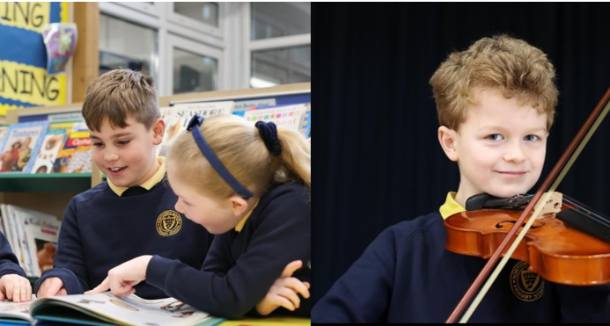
About the Role
Job Title:
Salary:
Contract Type:
Reporting to:
Inclusion Teaching Assistant
TA2 (Scale 5-6) Actual salary £17,818.68 - £18,509.16
Permanent (term time plus TED days), 30 hours per week
Assistant Head (Inclusion Lead) / Class Teacher /Year Group Lead
Start Date:
ASAP
About
We are seeking a passionate and dedicated Inclusion Teaching Assistant to join our school. Our Teaching Assistants play a vital role working alongside our class teachers to support our wonderful students to fulfil their potential and to develop their independence skills.
You will assist in promoting the learning and personal development of the pupils to whom you are assigned, to enable them to make best use of the educational opportunities available to them, including those with special needs..
Under the guidance of the AHT (Inclusion) and teaching staff, you will utilise your skills to ensure inclusivity. This will be required either individually or in group work as required, in or out of the classroom.

Slide 7
Job Description
Core Purpose
To assist in promoting the learning and personal development of the pupils to whom you are assigned, to enable them to make best use of the educational opportunities available to them, including those with special needs.
To assist in providing an effective and personalised teaching programme for individuals or groups of children supporting their specific learning need.
Work collaboratively with the teacher and other professionals to deliver outstanding, inclusive, and well-rounded education experience for all.
To support SLT in the implementation of all aspects of school in order to maintain the aims and ethos of the school and the Trust as a whole.
To demonstrate Trust values and high standards of professional conduct at all times
Key Accountabilities
To be responsible for supporting identified individuals and groups both academically and pastorally.
To work with the AHT (Inclusion) and subject teachers to plan and lead specific interventions (in areas such as speech and language, behaviour, reading, spelling, numeracy) with identified pupils and/or groups, undertaking baseline and end of unit assessments.
To support pupils and work collaboratively to ensure each child is making good progress, that need is being met
To work collaboratively with teaching staff, other TAs, and the AHT (Inclusion) to close the attainment gap between individual pupils and groups.
To provide particular support for pupils, including those with special needs, ensuring their safety and access to learning activities.
To liaise with class teachers, the AHT (Inclusion) and other professionals about individual education plans (IEPs), contributing to the planning as appropriate.
To provide additional nurture to individuals when requested by the class teacher or AHT (Inclusion).
To aid pupils with special needs to access all subjects of the national curriculum and encourage their independence as learners.
To assistant in the formulation and implementation of support plans as directed by AHT (Inclusion), in line with school policy.

Slide 8
Job Description (cont)
Key Accountabilities
To support individuals, small groups or a class of pupils, e.g. as they arrive/leave the class, at break time and lunchtime as required.
To provide regular feedback on children’s progress to the class teacher, Year group leads and AHT (Inclusion).
To accompany teaching staff and pupils on visits, trips and out of school activities as required and take responsibility for a group under the supervision of the teacher.
To meet the physical and/ or hygiene needs of pupils as required.
To establish constructive relationships with pupils and interact with them according to individual needs.
To promote good pupil behaviour, dealing promptly with conflict and incidents in line with established policy and encourage pupils to take responsibility for their own behaviour.
To support the use of ICT in learning activities and develop pupils’ competence and independence in its use.
To prepare, maintain and use equipment/resources required to meet the lesson plans/relevant learning activity and assist pupils in their use.
To assist teaching staff and other TAs with creating and maintaining displays throughout the school.
To establish and maintain constructive relationships with pupils’ parents .
To provide administrative and clerical support to teaching staff and other TAs as required.
To participate in Enrichment.

Slide 9
Job Description (cont)
Other
To have professional regard for the ethos, policies and practices of the school in which you teach, and maintain high standards in your own attendance and punctuality
A Teaching Assistant Level 2 may be called upon to provide cover supervision for a group or for a whole class for a session/lesson, this may involve the teaching assistant contributing to the planning, preparation, assessment and reporting.
Perform any reasonable duties as requested by the Headteacher.
Continuing Professional Development
Participate in training and other learning activities to develop the competencies to effectively support children and to ensure knowledge and skills are kept up to date.
Attend team and staff meetings.
Conditions of Employment
The School reserves the right to alter the content of this Job Description, after consultation, to reflect changes to the job or services provided, without altering the general character or level of responsibility.
The duties described in this Job Description must be carried out in a manner which promotes equality of opportunity, dignity and due respect for all employees and service users and is consistent with the School’s Equal Opportunities Policy and Code of Conduct.

Slide 10
Person Specification
Criteria | Essential | Desirable
Education / Qualifications | NVQ 2 for Teaching Assistants (or demonstrate equivalent knowledge skills and experience). Good numeracy/literacy skills. 5 GCSE’s with a minimum of Grade C or above in Maths and English (or equivalent qualifications) | Evidence of further CPD Current First Aid/Paediatric First Aid certificate Qualifications/training in social/emotional programmes, e.g. Elsa or Thrive / trauma informed practice Team Teach trained Training in the relevant learning strategies to support children with a range of needs e.g. Speech and Language
Experience | Experience of working within a Primary school – supporting children’s learning Experience of running intervention groups Experience of working with children with a variety of educational needs | Experience of leading relevant learning strategies eg, phonics
Skills and knowledge | Understanding of relevant policies/codes of practice. Good understanding of areas of learning, e.g. literacy, numeracy and SEND. An understanding of what constitutes high quality educational provision and the characteristics of effective learning Competent in the use of IT to support learning Have good level of knowledge and understanding of SEN and understanding of at least one area of learning e.g. English, Maths An awareness and an understanding of issues of inclusion, especially within a school setting Have excellent communication skills Ability to demonstrate positive and highly effective behaviour management skills | Has a strong understanding of behaviour management strategies and the ability to deliver targeted support programmes Delivering Speech and Language activities and programmes of work
Personal qualities | Ability to establish positive relationships with staff , pupils and parents Flexible and keen to adapt to the needs of the school. Be encouraging and supportive. High standards and expectations of pupils and yourself A positive outlook towards teaching and aiding children's development. Commitment to a collaborative approach to professional development Commitment to safeguarding and equality Self-motivated and well organised Commitment to maintaining confidentiality at all times. compassionate and patient approach Emotional resilience in working with challenging behaviours.

Slide 11
How to Apply
Application forms are available to download here:
Please email completed application forms to Miranda Giddings, nwoffice@riverscofe.co.uk by Tuesday 10th February 2026.
Interviews will take place on Thursday 26th February 2026.
We do not accept CVs.
We are committed to safeguarding and promoting the well-being of children and expect everyone to share this commitment. The successful applicant will undergo a full enhanced DBS check.

Slide 12
Get in Touch
Northwick Manor Primary School
Northwick Road, Worcester WR3 7EA
T: 01905 454430
E: nwoffice@riverscofe.co.uk
Northwick Manor Primary School – Home
The Rivers C of E Academy Trust
School Lane, Cutnall Green, Droitwich, WR9 0PH
T: 01299 851178
E: info@riverscofe.co.uk
W: www.riverscofe.co.uk/

